Slide 1
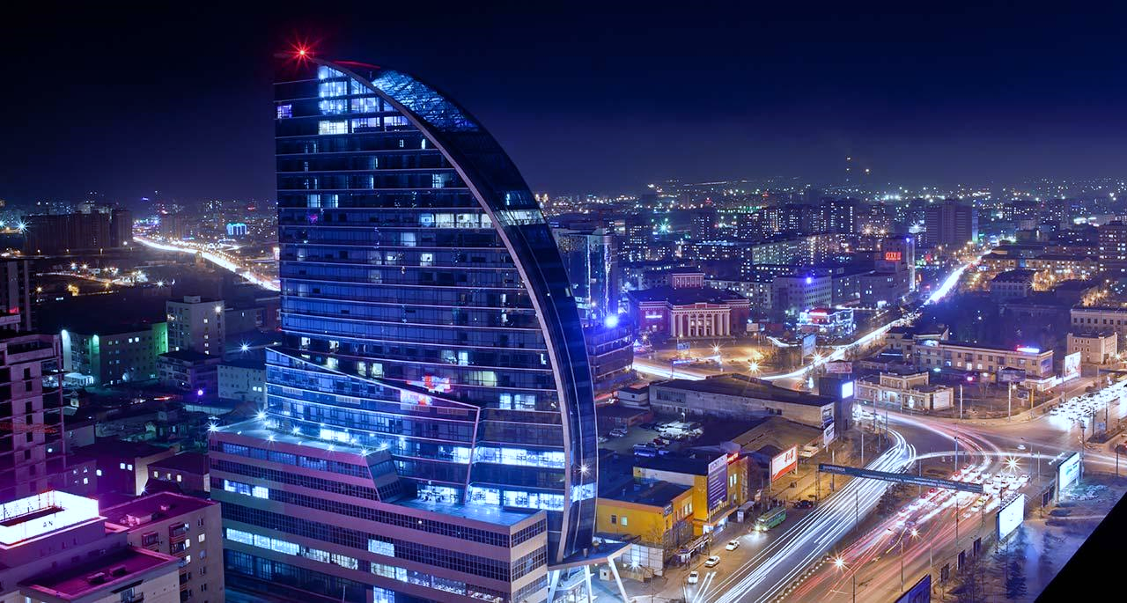
O.Nominchimeg
Deputy Governor of Ulaanbaatar City
TRANS-ALTAI SUSTAINABILITY DIALOGUE SDG16: PEACE, JUSTICE AND STRONG INSTITUTIONS
Strengthening the Participation of Developing Countries in Global Governance
O.NOMINCHIMEG
Deputy Governor of Ulaanbaatar City

Slide 2
Ulaanbaatar is an engine to a sustainable development of our country
The Law on Legal Status of Ulaanbaatar city was approved by parliament in 2021
INTEGRATED CITY PLANNING:
Satellite cities
Sub centers
Unit districts

Slide 3
“20 MINUTES CITY”
A citizen can be accessible to every necessity within only 20 minutes where they reside
Decentralization means to Strengthen Global Influence

Slide 4
Emphasizing Local Challenges to Highlight Global Issues
Total of 14 projects and programs are being implemented in collaboration with international organizations

Slide 5
THANK YOU FOR YOUR ATTENTION!

