Slide 1
AN ANALYSIS ON TURKISH-MONGOLIAN RELATIONS IN HISTORY AND THEIR COMMON TRADITIONAL CULTURES
Prof. Dr. Varis ÇAKAN
Ankara Hacı Bayram Veli University, Faculty of Letters, Department of History varis.cakan@hbv.edu.tr, variscakan@gmail.com.

Slide 2
As is known, Turks have lived in North and Central Asia, including present-day Mongolia, since the early periods of history and have established great states.
Turks, along with Mongols and other neighboring communities, have formed the 'Great Steppe Culture' across the Eurasian geography stretching from present-day Mongolia to Hungary.
Consequently, Turks and Mongols, who constituted this cultural type, have exhibited certain common characteristics in the religious, social, and economic fields, and together they have established large states culturally resembling each other in this geography.
The pre-Islamic Turkish states known as the Huns, Gokturks, and Uyghurs are the eras in which the foundation of these common cultures and values ​​was formed.

Slide 3
According to information obtained from archaeological excavations, the earliest known ancestors of the Mongols, the Tunguz (Tungus), lived east of the Ti and Rong tribes, ancestors of the Turks, from the 2nd millennium BCE, and the Tuul River was considered the border between these two neighboring communities.
During this period, the ancestors of the Mongols had spread from east of the Tuul River to the west and southwest of present-day Manchuria.
Later, starting from the 4th century BC with the emergence of the Huns onto the historical stage, it is observed that the interactions between the Mongols and the Turks intensified.
With the accession of Batur Tanrikut to the throne, the Huns extended their dominion to include the Tungus in the east, the Yüeh-ch’i in the west, and the city-states of Central Asia, expanding their sway to the shores of the Caspian Sea, bordering the Roman Empire.
During this period, the Turks and Mongols lived under the same rule, thus being shaped within a shared cultural sphere.

Slide 4
After the fall of the Asian Hun Empire, historians argue that the power vacuum in Asia was filled by the Sienpi, a result of the mixture of ancient Mongol tribes with some Turkish tribes.
The Sienpi were predominantly a confederation composed of Turkish and Mongol tribes, and during this period, they continued deep relations with both Turks and Mongols, sharing a common destiny.

Slide 5
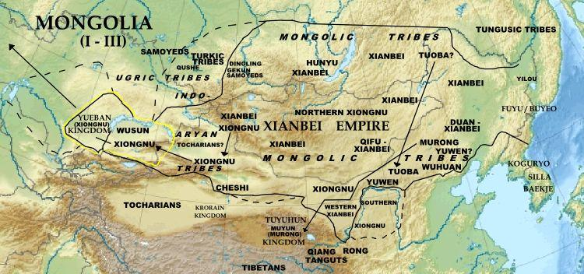

Slide 6
At the beginning of the 3rd century AD, in the year 233 AD, after the dissolution of the Sienpi Confederation, the Tabgach (Tuoba) tribe established the Northern Wei Dynasty in the region.

Slide 7
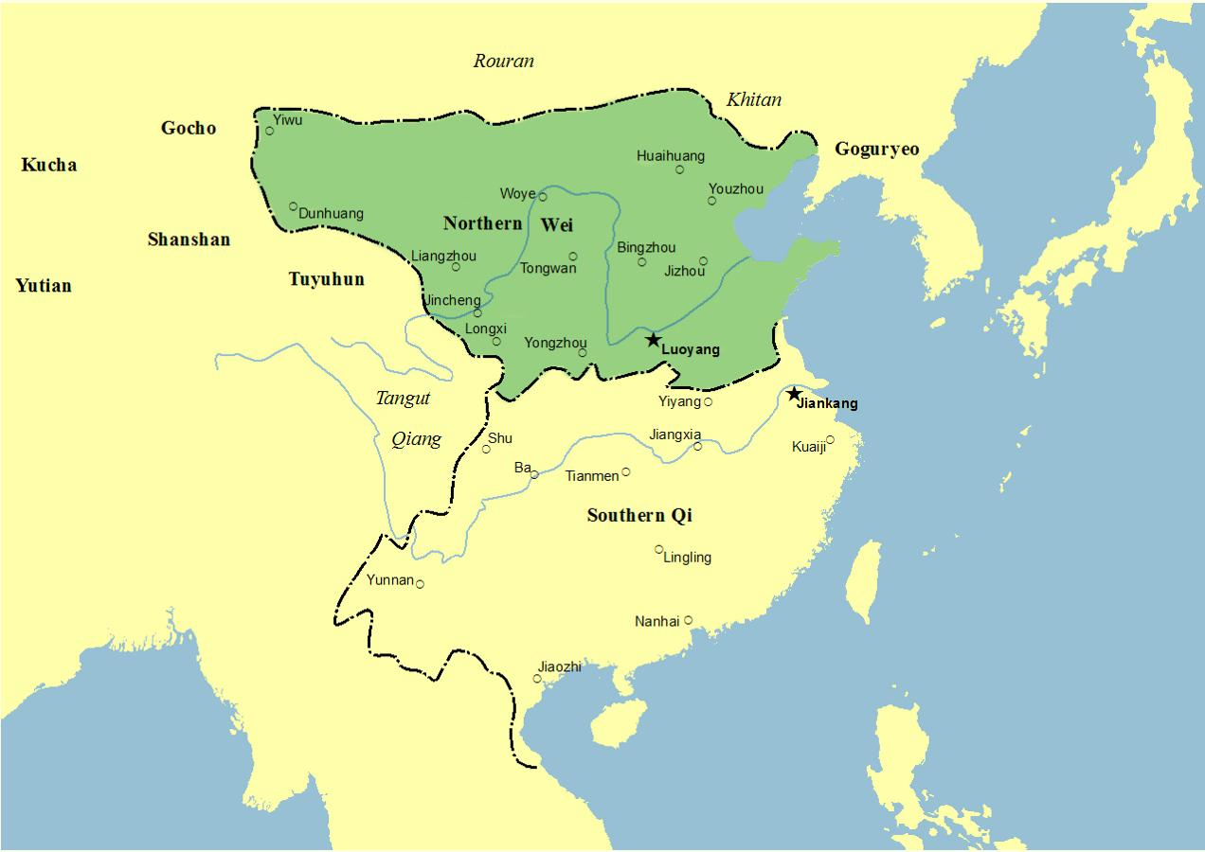

Slide 8
The Toba Wei State, established by the Toba (Tabgach) clan of the Sienpi, was a Turkic-Mongolian mixed dynasty that ruled Northern China from 386 to 535.
Since its foundation, during the Northern Wei period marked by political struggles and intense social and cultural changes, Northern China was unified, and the 16 kingdoms in China were brought to an end.
The unification of Northern China marked the beginning of the Southern and Northern Dynasties period in Chinese history.

Slide 9
In 439, the third emperor, Tai Wu Di, of the Toba Wei State, destroyed the Xia and Northern Liang kingdoms established by the Hun tribes in northern China, suppressed Buddhism on the advice of the Taoist Kou Qian-zhi, and began to emphasize Confucianism.
However, because other rulers continued to support Buddhism, Buddhist culture did not disappear.
Tai Wu Di pursued a policy of Sinicization (Chinese assimilation) in his country, replacing the existing tribal system with an aristocratic one.
As a result, some Toba and Sien-pi individuals loyal to the traditions of the Huns and Mongols opposed these policies, leading to the "Rebellion of the Six Garrisons" in 524.
Although the rebellion was suppressed, the political power of the soldiers who suppressed it increased, leading the state towards division.
In 534, the state was divided into Eastern and Western Wei.

Slide 10
As a result of not taking serious measures, the process of Sinicization, which is synonymous with Buddhism, has also begun.
Finally, Emperor Xiao Wen Di (471 - 499), who was also a Buddhist, moved his capital from the northern steppe region to Lo-Yang, where the Chinese population was dense.
Thus, the assimilation process of the Tobas began.
As a result of assimilation policies, the Sinicized Eastern and Western Wei states were replaced by the Northern Ch'i and Northern Chou states, and the traces of the Tobas were lost.

Slide 11
The Turkic and Mongol tribes, unwilling to abandon their ancient traditions, later came under the dominion of the Juan-juan, which emerged in northern Asia.

Slide 12
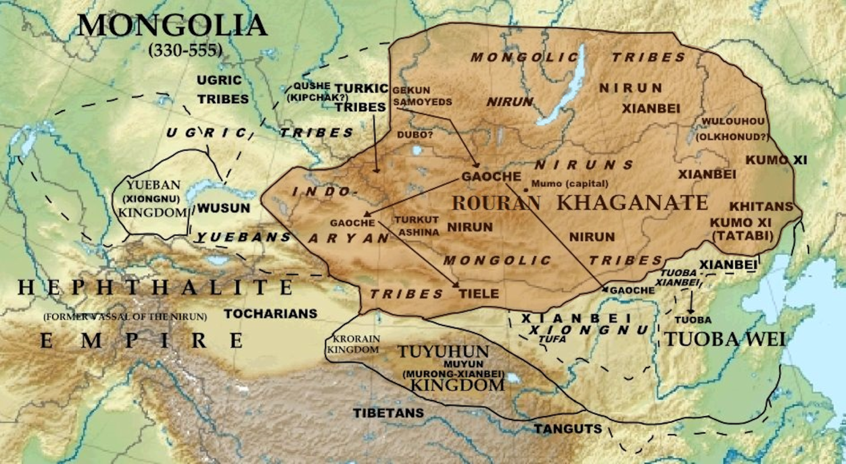

Slide 13
The Juan-juans (柔然/Róurán/Jou-jan) were related to the Mongols.
They were a nomadic community living in northern Asia from the 3rd to the 6th century AD, and the Turks referred to them as "Apar" (Avar).
However, whether there is any connection between them and the Avar state established in Eastern Europe between the 6th and 9th centuries is still a matter of debate.

Slide 14
After the collapse of the Toba Wei state in Northern Asia, the Juan-juans established a vast dominion from the late 5th century AD, encompassing present-day inner and outer Mongolia to the Korean Peninsula.
Following the Huns, the Göktürks, who founded a great empire in Northern and Central Asia, emerged at the foot of the Altai Mountains under the rule of the Juan-juans.
Subsequently, the Göktürks gained strength and in 552, they abolished the rule of the Juan-juans, establishing the Göktürk Khaganate.

Slide 15
The Göktürk state quickly expanded into a vast empire stretching from the Korean Peninsula in the east to the Black Sea in the west, uniting under one banner the tribes and peoples inhabiting present-day Mongolia and the entire Central Asian region.
Sources indicate that during the Göktürk rule, proto-Mongol tribes such as the Kitans (契丹), Hsi (奚), Kumoxi (庫莫奚), Mongols (蒙兀儿), and Shi-wei (室韋) lived intertwined with the Göktürks in present-day Mongolia, influencing each other's cultures and traditions.

Slide 16
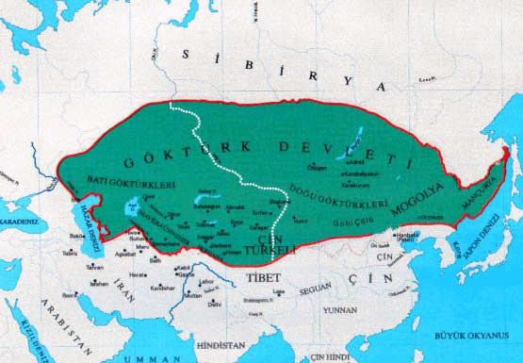

Slide 17
In 630, when the Göktürks entered a period of internal strife, some Mongol tribes began to act independently.
Certain Mongol tribes residing in the southern regions came under the rule of China.
In 682, with the restoration of Göktürk power under Kutluk Khan, emerging from the period of internal strife, Mongol tribes once again fell under Göktürk dominion and shared a common destiny with the Göktürks.
When the Göktürk era ended in 744 and the Uygur state was established, the Mongols continued to live together in the same cultural sphere as one of the important vassals of the Uygur state.

Slide 18
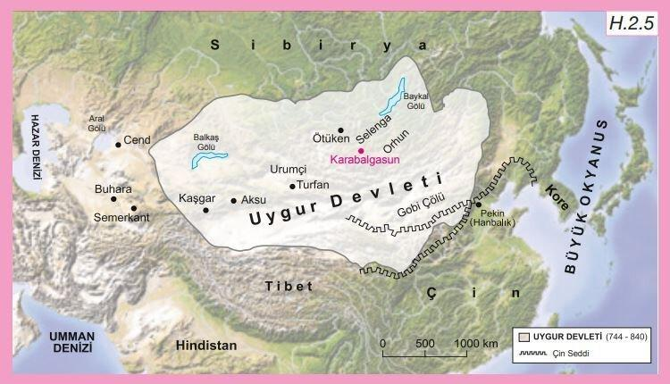

Slide 19
It is possible to say that the Mongols were particularly influenced by the Uyghurs in their religious and cultural lives.
This is because sources often refer to the Uyghurs when providing examples related to Mongolian traditional culture.
Contemporary sources generally mention practices belonging to the Uyghur Turks and then indicate the presence of similar practices among the Mongols.

Slide 20
Today, numerous monumental tombs and inscriptions dating back to the Gökturks and Uyghurs have been unearthed from various regions of Mongolia, and these are preserved as memories of Turkic-Mongolian unity.
At the same time, these artifacts serve as undeniable evidence of the friendship and brotherhood between the Turkic and Mongolian peoples who continue to live together in Northern and Central Asia.

Slide 21
It is noted in Chinese sources that the Mongolian tribe known as "Shih-wei" laid the foundation of traditional Mongolian culture before the 10th century, and this culture resembled the Turkic cultures of the Hun, Göktürk, and Uyghur periods.
Additionally, we can also prove these similarities archaeologically.
It has been observed that the Shih-wei people used mobile homes (cart houses) like the Huns and Göktürks, bows made from horns, whistling arrows, weapons, flat-bottomed skis, and leather clothing.
The resemblance in the names of many tools used in everyday life related to animal husbandry, hunting, and agriculture is also an example of the cultural closeness between the two communities.

Slide 22
After the collapse of the Uyghur State in 840 due to internal political conflicts, natural disasters, and subsequent attacks by the Kyrgyz, many Turkic tribes in the Ötüken and Orkhon regions migrated with the Uyghurs to the western borders of present-day Turkistan.
Following the Great Turkic Migration, proto-Mongol tribes began to predominate in the territory of present-day Mongolia.
Some Turkic tribes that did not leave the region during the Uyghur migration mixed with Mongol tribes, contributing to their emergence on the historical stage.
One example of this is the Khitan State established in North Asia in 916.

Slide 23
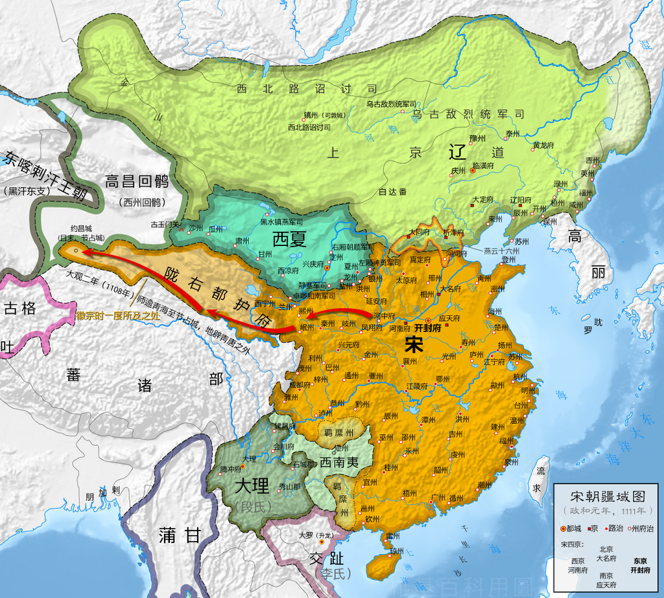

Slide 24
In the early 10th century AD, Yelü Apauchi, the leader of the Khitan tribe, subjugated all the clans and became dominant over much of Mongolia, declaring himself ruler in 916.
His son, Emperor Te Kuang (926-947), conquered part of Northern China and established the state known as the Liao Dynasty by the Chinese.
The Liao Empire, which ruled over Northern China for more than two centuries, extended its southern borders from present-day Shanxi province, including present-day Beijing, to the north of the Chili province; moreover, all Mongolian and Manchurian peoples, including the Kyrgyz, were also subject to this empire.

Slide 25
In 1009, the Khitans turned westward and began to threaten the Uyghurs and the Karakhanids.
However, they were defeated by the Karakhanids near Balasagun (in 1016), delaying their advance westward by a century.
After the fall of the Liao Dynasty, much of the Khitan population accepted the rule of the Jurchens, who were of Tungusic origin, while Prince Yelü Tashi, the eighth-generation descendant of Apauchi, rallied a small group under his command and gained the support of many tribes in Western Mongolia before advancing towards Turkistan.

Slide 26
Between 1121 and 1126, under the command of Yelü Taishi, the Karakhanid army made contact with the Islamic world.
In 1128, when the Karakhanid ruler, Arslan Khan Ahmad ibn Hasan, defeated them as they entered Balasagun, Hotan, and Kashgar regions.
However, in the spring of 1130, after crossing the Kyrgyz lands along the Yenisey River, Yelü Taishi turned southwest again, establishing the city of Imil in Tarbagatai.
Upon the Karakhanid ruler's request for help against pressure from the Karluk and Kangar tribes, he reached Balasagun without encountering any resistance and took advantage of the opportunity to establish the Karakhanid State, making Kashgar, Beşbalık, and Hotan subordinate to him (1130).
Because Yelü Taishi was affiliated with the Liao Empire, Chinese sources referred to this state as Hsi Liao (Western Liao).
In Turkic-Islamic sources, this state is referred to as "Karakhanid" to distinguish it from the Liao Empire in Northern China.

Slide 27
Subsequently, Yelü Taishi, known by the title "Gürhan" (1130-1142), organized several expeditions to reclaim his former lands in Northern China, but without much success.
He then turned westward, attacking Transoxiana and Eastern Iran.
In 1137, near Hucend, he defeated Mahmud ibn Muhammad, the Western Karakhanid ruler under the protection of Sultan Ahmed Sanjar of the Seljuk Empire.
Later, in the Battle of Qatvan (September 9, 1141), he inflicted a heavy defeat on Sultan Sanjar, expanding his borders.
At its widest extent, the borders of the Karakhanid State extended from the Hsing hsih-xia pass in the west of China to the Nayman territory in the Altai Mountains to the north, to the Jeyhun River in the west, and to Belh and Termez in the south.

Slide 28
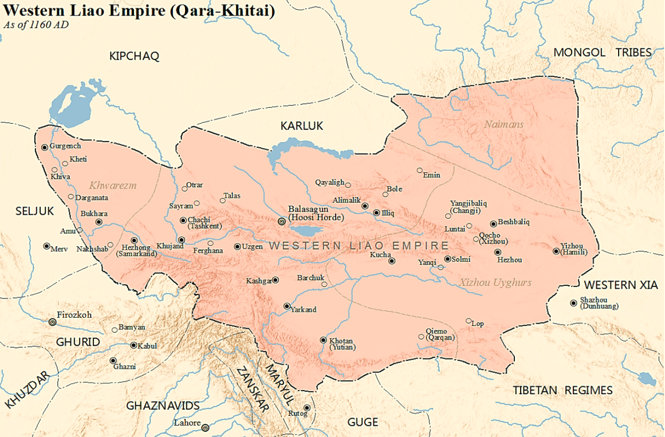

Slide 29
The Karakhanids, depicted as idolaters in Islamic sources, practiced a blend of Buddhism and Shamanism in their religious beliefs.
Ibn al-Athir portrayed the early rulers of the Karakhanids as Manicheans.
Although they did not embrace Islam, the Karakhanids generally showed tolerance towards all religions and beliefs.
As a result, cultural interactions between Turkic and Mongol peoples intensified.
It is also narrated in sources that the last Gürhan Ch'eluku secretly converted to Islam.
Since the Karakhanids resided in the steppes rather than the cultivated lands of Turkestan while ruling, their cultural interactions were more intense with Turkic tribes such as the Kyrgyz and Kipchaks who lived in the steppes of Turkestan.
Today, traces of the Karakhanids can be found in the steppes of Kazakhstan and Kyrgyzstan.

Slide 30
After the Karakhanids, we witness the emergence of Mongol tribes in the historical scene of North and Central Asia, referred to as "Tatars" in Islamic sources.

Slide 31
The Mongols began to play a significant role in world history with the establishment of the Mongol Empire by Genghis Khan in the early 13th century.
After long struggles, Genghis Khan succeeded in uniting all Mongol tribes under a single state.
After assuming the title of Genghis Khan in 1206, he gradually brought the Kyrgyz, Merkit, Naiman, and Idiqut Uyghurs under his rule by 1209.
With the counsel of Buddhist Uyghurs he incorporated, Genghis Khan introduced administrative, social, and military reforms, organizing the Mongols into a regular structure for the first time in their history.
Subsequently, after the end of Karakhanid domination in Central Asia, he extended his authority over Eastern Turkestan under the rule of the Naiman prince Küchlük, reaching the eastern borders of the Khwarezmian Empire.

Slide 32
In 1218, following the massacre of a 450-member Mongol caravan and the killing of its envoys and plundering of their goods in Otrar, Genghis Khan launched a campaign against the Khwarezmshahs the next year (1219) with a powerful army, invading the cities of Otrar, Samarkand, Bukhara, and Khujand.
Thus, the political and cultural relations between the Mongols and the Muslim Turks in Central Asia began to develop in a different dimension.

Slide 33
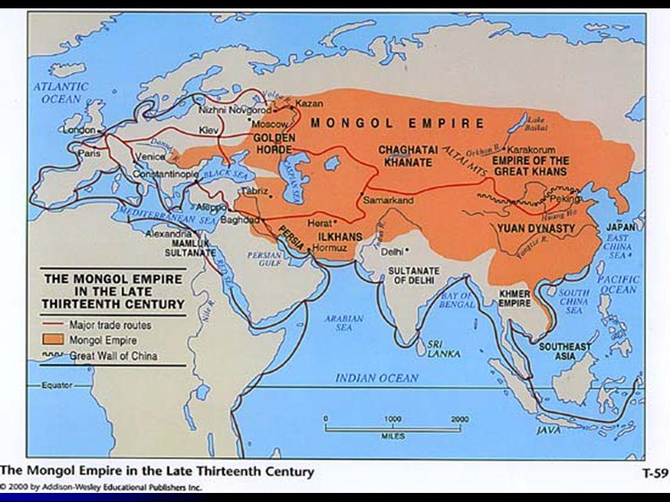

Slide 34
"The Secret History of the Mongols" serves as the main source for many works about the Mongols.
This work is the most important source describing Genghis Khan's lineage, life story, religious beliefs, and ideas of dominion.
When the information in this source is carefully examined, it will be easily noticed that the state of Genghis Khan rose upon the cultural heritage of pre-Islamic Turkic states.

Slide 35
Benefiting from the legacies of the Hun, Göktürk, and Uygur states, Genghis Khan also embraced the idea of world domination that was inherent in these mentioned states.
The most prominent clues to this are seen in Genghis Khan tracing his lineage back to the sacred Gray Wolf, much like the Göktürks.
Genghis Khan considering himself the ruler of the universe and basing the legitimacy of his rule on divine sources is a fundamental principle inherent in the essence of the Hun, Göktürk, and Uygur states.
The concept of God being represented by the Khan and the reinforcement of this belief with cosmic elements also traces back to ancient Turkic roots.

Slide 36
According to the Turkic concept of dominion, the Turkic khan, appointed by God, is the representative and shadow of God on earth.
Just as there is a God in the sky, there will also be a Khan on earth.
It is widely accepted in the scientific community that the concept of "Tegri" in Mongolian passed from the Turkic "Tengri ".
The Mongols explain Genghis Khan's coming into the world as being linked to the realization of divine purposes.
Similar to the story of Oğuz Khan walking and hunting forty days after his birth, Genghis Khan was born holding a blood clot in his hand.

Slide 37
While the Mongols adopted Turkic culture, epic traditions, Uygur script, and many institutions from the Uygurs, they also assimilated the idea of world domination along with their officials and administrative structure.
As it is known, the concept of world domination among the Turks was supported by religious elements.
As it is known, the concept of world domination among the Turks was supported by religious elements.
Within Turkish culture and religious history, the belief in God not only influenced spiritual realms but also played a role in shaping the political and social order of society.

Slide 38
One of the most important principles underlying the concept of world domination among the Turks is the belief in God.
In the Turkic conception, the sky is envisioned as the dwelling place of God.
The same conception was present among the Mongols as well.

Slide 39
Alongside the belief in Gök Tanrı (Heavenly God), Shamanistic elements, Ancestor Worship, and elements of Earth-Water worship were present among the Mongols, both during the reign of Genghis Khan and in the periods that followed.
Plano Carpini, an envoy of the Pope who visited the Mongol state during the reign of Güyük Khan, noted that the majority of those living in the Central Asian steppes at that time were predominantly Shamanistic.

Slide 40
Muslim historians directly attribute Shamanistic powers to Genghis Khan.
This situation is actually applicable to ancient Turkic Khans as well.
Some scholars emphasizing the importance of Khans in Turkic religious life claim that Khans had certain religious functions and resembled Shamans.
The significant role played by Shamans in Uyghur society was therefore applicable to Genghis Khan as well.

Slide 41
Thus, the role of Shamans in prophecy, fortune-telling, medicine, and magical activities continued in the state of Genghis Khan just as before.
The 13th-century historian Juvayni, when mentioning the Uyghurs, says: "The Uyghurs have always acted according to the words of Shamans.
Before embarking on an important task, they consult the soothsayers and Shamans, and do not start work without their favorable opinion."

Slide 42
One of the methods Shamans use for prophesying about the future is to look at the scapula bone.
Western sources narrate that Attila, the King of the European Huns, had a scapula bone reading done during a battle against the Visigoths and Alans in 451.
Here, a sheep was slaughtered, and its scapula bone was burnt in fire, and by interpreting the shape the bone took in the fire, they tried to learn about the outcome of the battle.
Mahmud al-Kashgari also states in his work, "If the scapula bone cracks, the province will be troubled.«
Traces of the same belief are also seen among the Mongols.
Marco Polo, when speaking about the Mongols, narrates how a Shaman throws sheep's scapula bones into the fire and reads the fate of people from the cracks that form on the bones.

Slide 43
In Mahmud al-Kashgari’s work, he says, "If the scapula bone cracks, the province will be troubled".
Traces of the same belief are also seen among the Mongols.
Marco Polo, when speaking about the Mongols, narrates how a Shaman reads people's fate from the cracks that form on the scapula bones by throwing sheep's scapula bones into the fire.

Slide 44
The magical activities practiced in the state of Genghis Khan are also remarkable.
Cüveyni provides the following information about the Kamlars among the Uyghurs: "The reason for the Uyghurs' idolatry was this; At that time, they had learned the art of magic. They called those who dealt with it 'kam' (Shaman)".
In this sense, one of the magical methods practiced in the Turkic cultural sphere is the action of inducing rain with a "Yada" stone.
This practice, mentioned in Islamic sources with ample details, is also observed among the Mongols.

Slide 45
Another element existing in the history of Turkic religion is the cult of Earth and Water.
Turks believed that the spirits they believed existed in nature resided in places such as mountains, seas, forests, and lakes, and they believed that these places were their protectors.
Traces of the same belief are also seen in Genghis Khan.
According to Mongolian tradition, in one of the battles fought to conquer Mongolia, Genghis Khan took refuge in the Burhan Khaldun mountain after a failure, and despite his enemies circling the mountain three times in search of him, they could not find him.
After escaping, Genghis Khan sacrificed to this mountain, circumambulated it nine times, and scattered mare's milk as a sign of gratitude.
As a reminder of this deliverance, he instructed his descendants to sacrifice to this mountain.

Slide 46
Another reason for Turks attributing sanctity to mountains is that, according to the beliefs of ancient Turks, the highest mountain peaks were the places closest to the God who dwelled in the sky.
Therefore, the graves of great individuals among the Turks were generally found at the tops of mountains.
Similarly, especially members of the Mongol dynasty were buried in places that were difficult to reach throughout the Mongol Empire, particularly on high mountain peaks, as agreed upon by all sources.

Slide 47
Another similarity observed between Turks and Mongols is the sanctification of water. Various sources mention that Turkish communities in history attributed sanctity to water.
Similarly, water is sanctified in the laws of Genghis. Urinating in water was a major offense punishable by death.
Unlike the Turks, in Genghis's realm, people did not wash with laundry soap. Dirty clothes were discarded and replaced with new ones.
Utensils such as pots, pans, and dishes were not washed with water; they were cleaned with grass and soil.
The sanctity of water came from the "earth-water" deity that resided within it.

Slide 48
The Mongols have also drawn from Turkish culture in terms of state administration and organization.
We cannot overlook the influence of the Uyghurs on the administration of Genghis Khan's state.
It is undeniable that the source of the Mongol code known as "Yasa" of Genghis Khan is also linked to Turkish tradition.
Additionally, scholars have demonstrated that terms related to state administration such as law, tradition, nation, flag, and decree have been transferred from Turkish to Mongolian.

Slide 49
Some historians have concluded, based on scientific research, that the great Mongol state established by Genghis Khan benefited from the ancient Turkish forms of state governance and culture.
Therefore, in Central Asia and Middle Eastern countries, the state established by Genghis Khan is also referred to as the "Turkish-Mongol state."

Slide 50
From the 13th century onwards, the gradual settlement of the Mongols into Turkish-Islamic cultural areas and surroundings, along with their control over important caravan routes, enabled them to exert control over these points.
This led to continuous interaction and exchange with Turkish-Islamic culture.
As a result, the Mongols, who were strong representatives of nomadic culture, also became carriers and representatives of the Turkish-Islamic culture with which they interacted.

Slide 51
From the second half of the 14th century onwards, the Golden Horde and Chagatai Khanate also entered a rapid Turkification process.
While the western part of the Chagatai realm fell under the influence of Amir Timur from the 1370s onwards, the eastern Mongols, under the leadership of Tokhtamysh, were imbued with Turkish-Islamic culture through the conversion to Islam of 160,000 Mongol households during Timur's reign.
Subsequently, Mongols living in Western Asia, the Middle East, and Eastern Europe successively embraced Islam and Turkified, while those in East Asia came under the influence of Chinese culture.

Slide 52
Mongols who remained in their homeland continued to live by engaging in frequent wars with each other in various tribal federations after the 16th century.
Later, the Mongols in North Asia, including present-day Mongolia, came under the rule of the Manchu, who were originally of Mongol origin but later sinicized, starting from 1691.
This situation persisted until the establishment of the Mongolian People’s Republic (later the Republic of Mongolia) in 1921.
Today, Mongols live not only in the Republic of Mongolia but also in the People's Republic of China, including the Uyghur Autonomous Region under its occupation, the Russian Federation, Tibet, the Central Asian Turkic republics, and Afghanistan.

Slide 53
Although the number of Mongols living under the administration of the People's Republic of China is greater than those in Mongolia, maintaining their traditional culture within the vast Chinese cultural sphere is becoming increasingly challenging for them.
The difference between Mongols living in Northern Mongolia and Southern Mongolia resembles the situation between North and South Korea, due to political and ideological reasons in Asia.
As long as Asia does not embrace a democratic system, this situation will continue to pose an obstacle to peace and stability on the Asian continent.

Slide 54
As mentioned above, Turks and Mongols coexisted side by side and intermingled in the steppes of Mongolia and Central Asia until the 10th century, giving rise to various shared cultures and states, which they developed together.
As a result of these close relationships, some Mongol tribes became Turkicized, while some Turkic tribes became Mongolized.
Therefore, in the sources, especially in Western sources, some Turkic tribes cannot be distinguished from Mongol tribes.

Slide 55
Whenever a Turkic tribe established a large state, the surrounding Mongols would submit to it, and similarly, when a Mongol tribe established a state, the surrounding Turks would submit to it.
When states fragmented and collapsed, some formed small khanates in their own regions and continued to govern themselves, while others migrated to other places and became assimilated.
Those who remained in their homeland and continued to live according to their own culture, like those in present-day Mongolia, continued to live as Mongols.

Slide 56
To summarize, the historical sharing of the same geography by Turks and Mongols for a considerable period, the linguistic relationship between Turkish and Mongolian stemming from years of coexistence, as well as belonging to the same language family, and furthermore, the presence of a significant portion of ancient Turkish cultural assets within the borders of present-day Mongolia, bring Turkish and Mongolian researchers together frequently in Turkic Studies.
Additionally, there is a substantial interest in Mongolian history in Turkey, particularly in the era of Genghis Khan and his successors, leading to significant research on Mongolian history.

Slide 57
Additionally, there is a substantial interest in Mongolian history in Turkey, particularly in the era of Genghis Khan and his successors, leading to significant research on Mongolian history.
The millennia-long history of these communities has been shaped by mutual interactions and integrations during critical moments in regional and global history.

Slide 58
THANK YOU!

