Slide 1
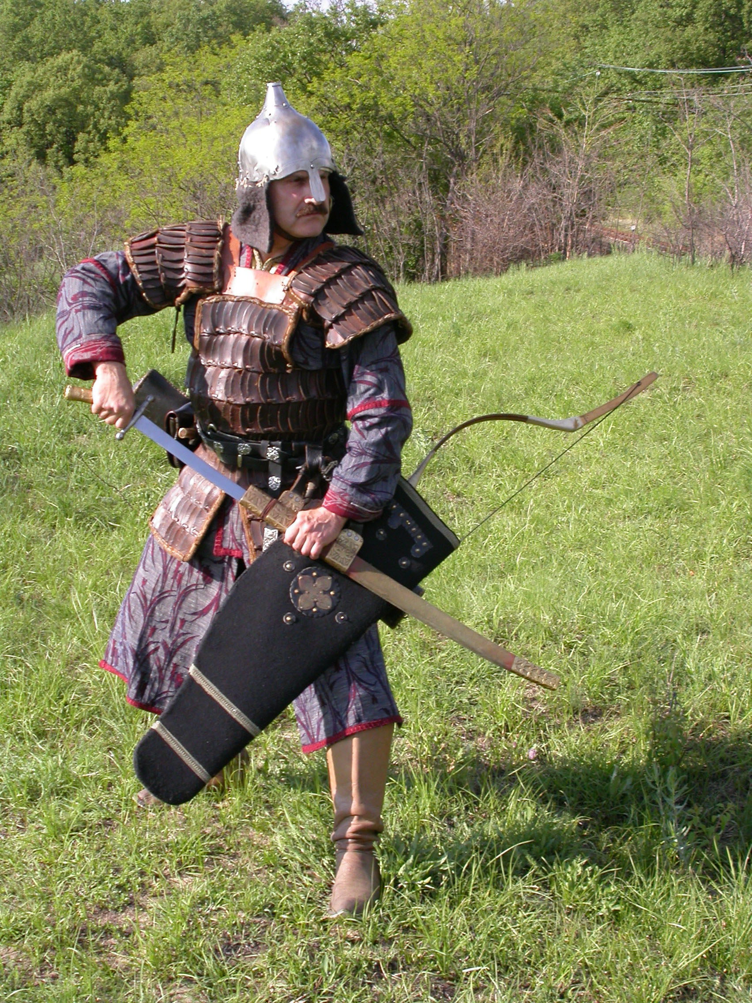
Close combat –close combat weapons used by nomads of the steppe
Dr. Hidán Csaba László
associated professor
Károli Gáspár University
Hungary

Slide 2
Nomad armys
Excellent mounted archers
Well equipped with close combat weapons as well
Body and head protected by armor and helmet
Historical sources: written sources, archeological founds, art
Period: from pre-hunnu age until late middle ages
Inventors of a lot of close combat weapons
Skillful warriors in close combat

Slide 3
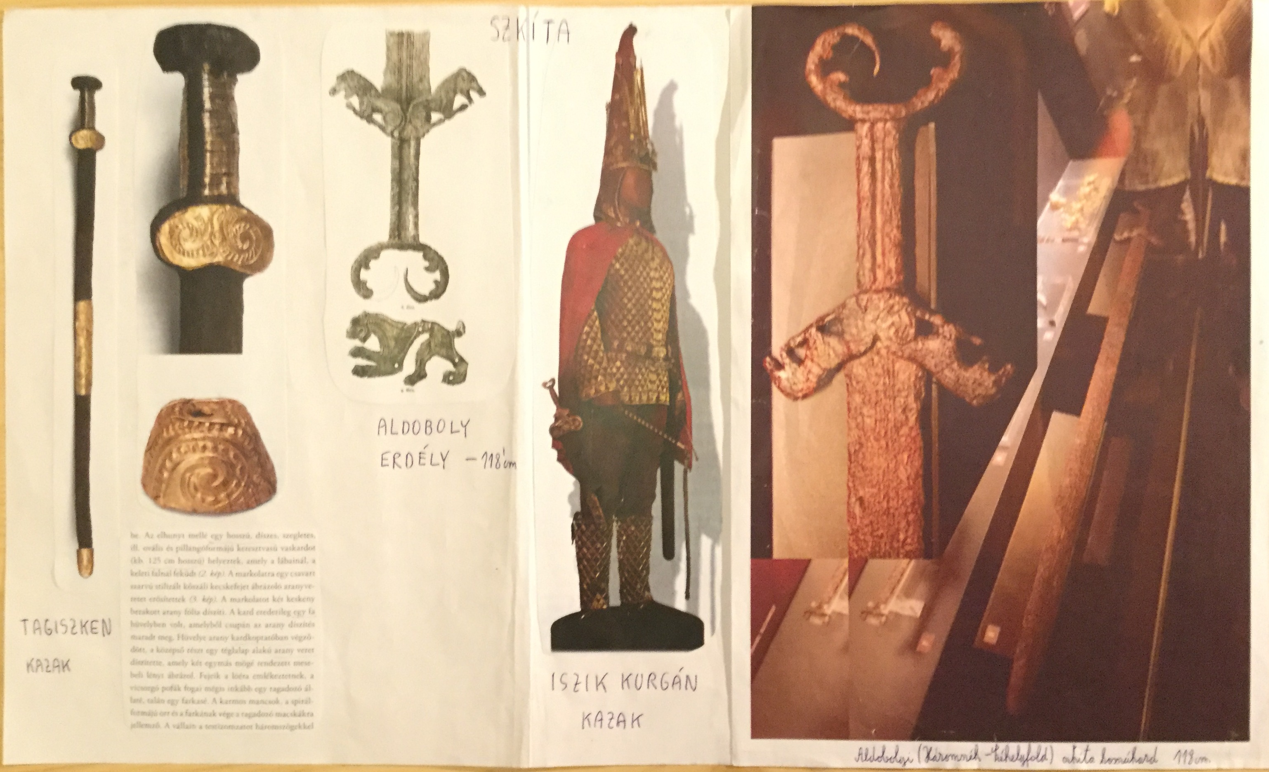
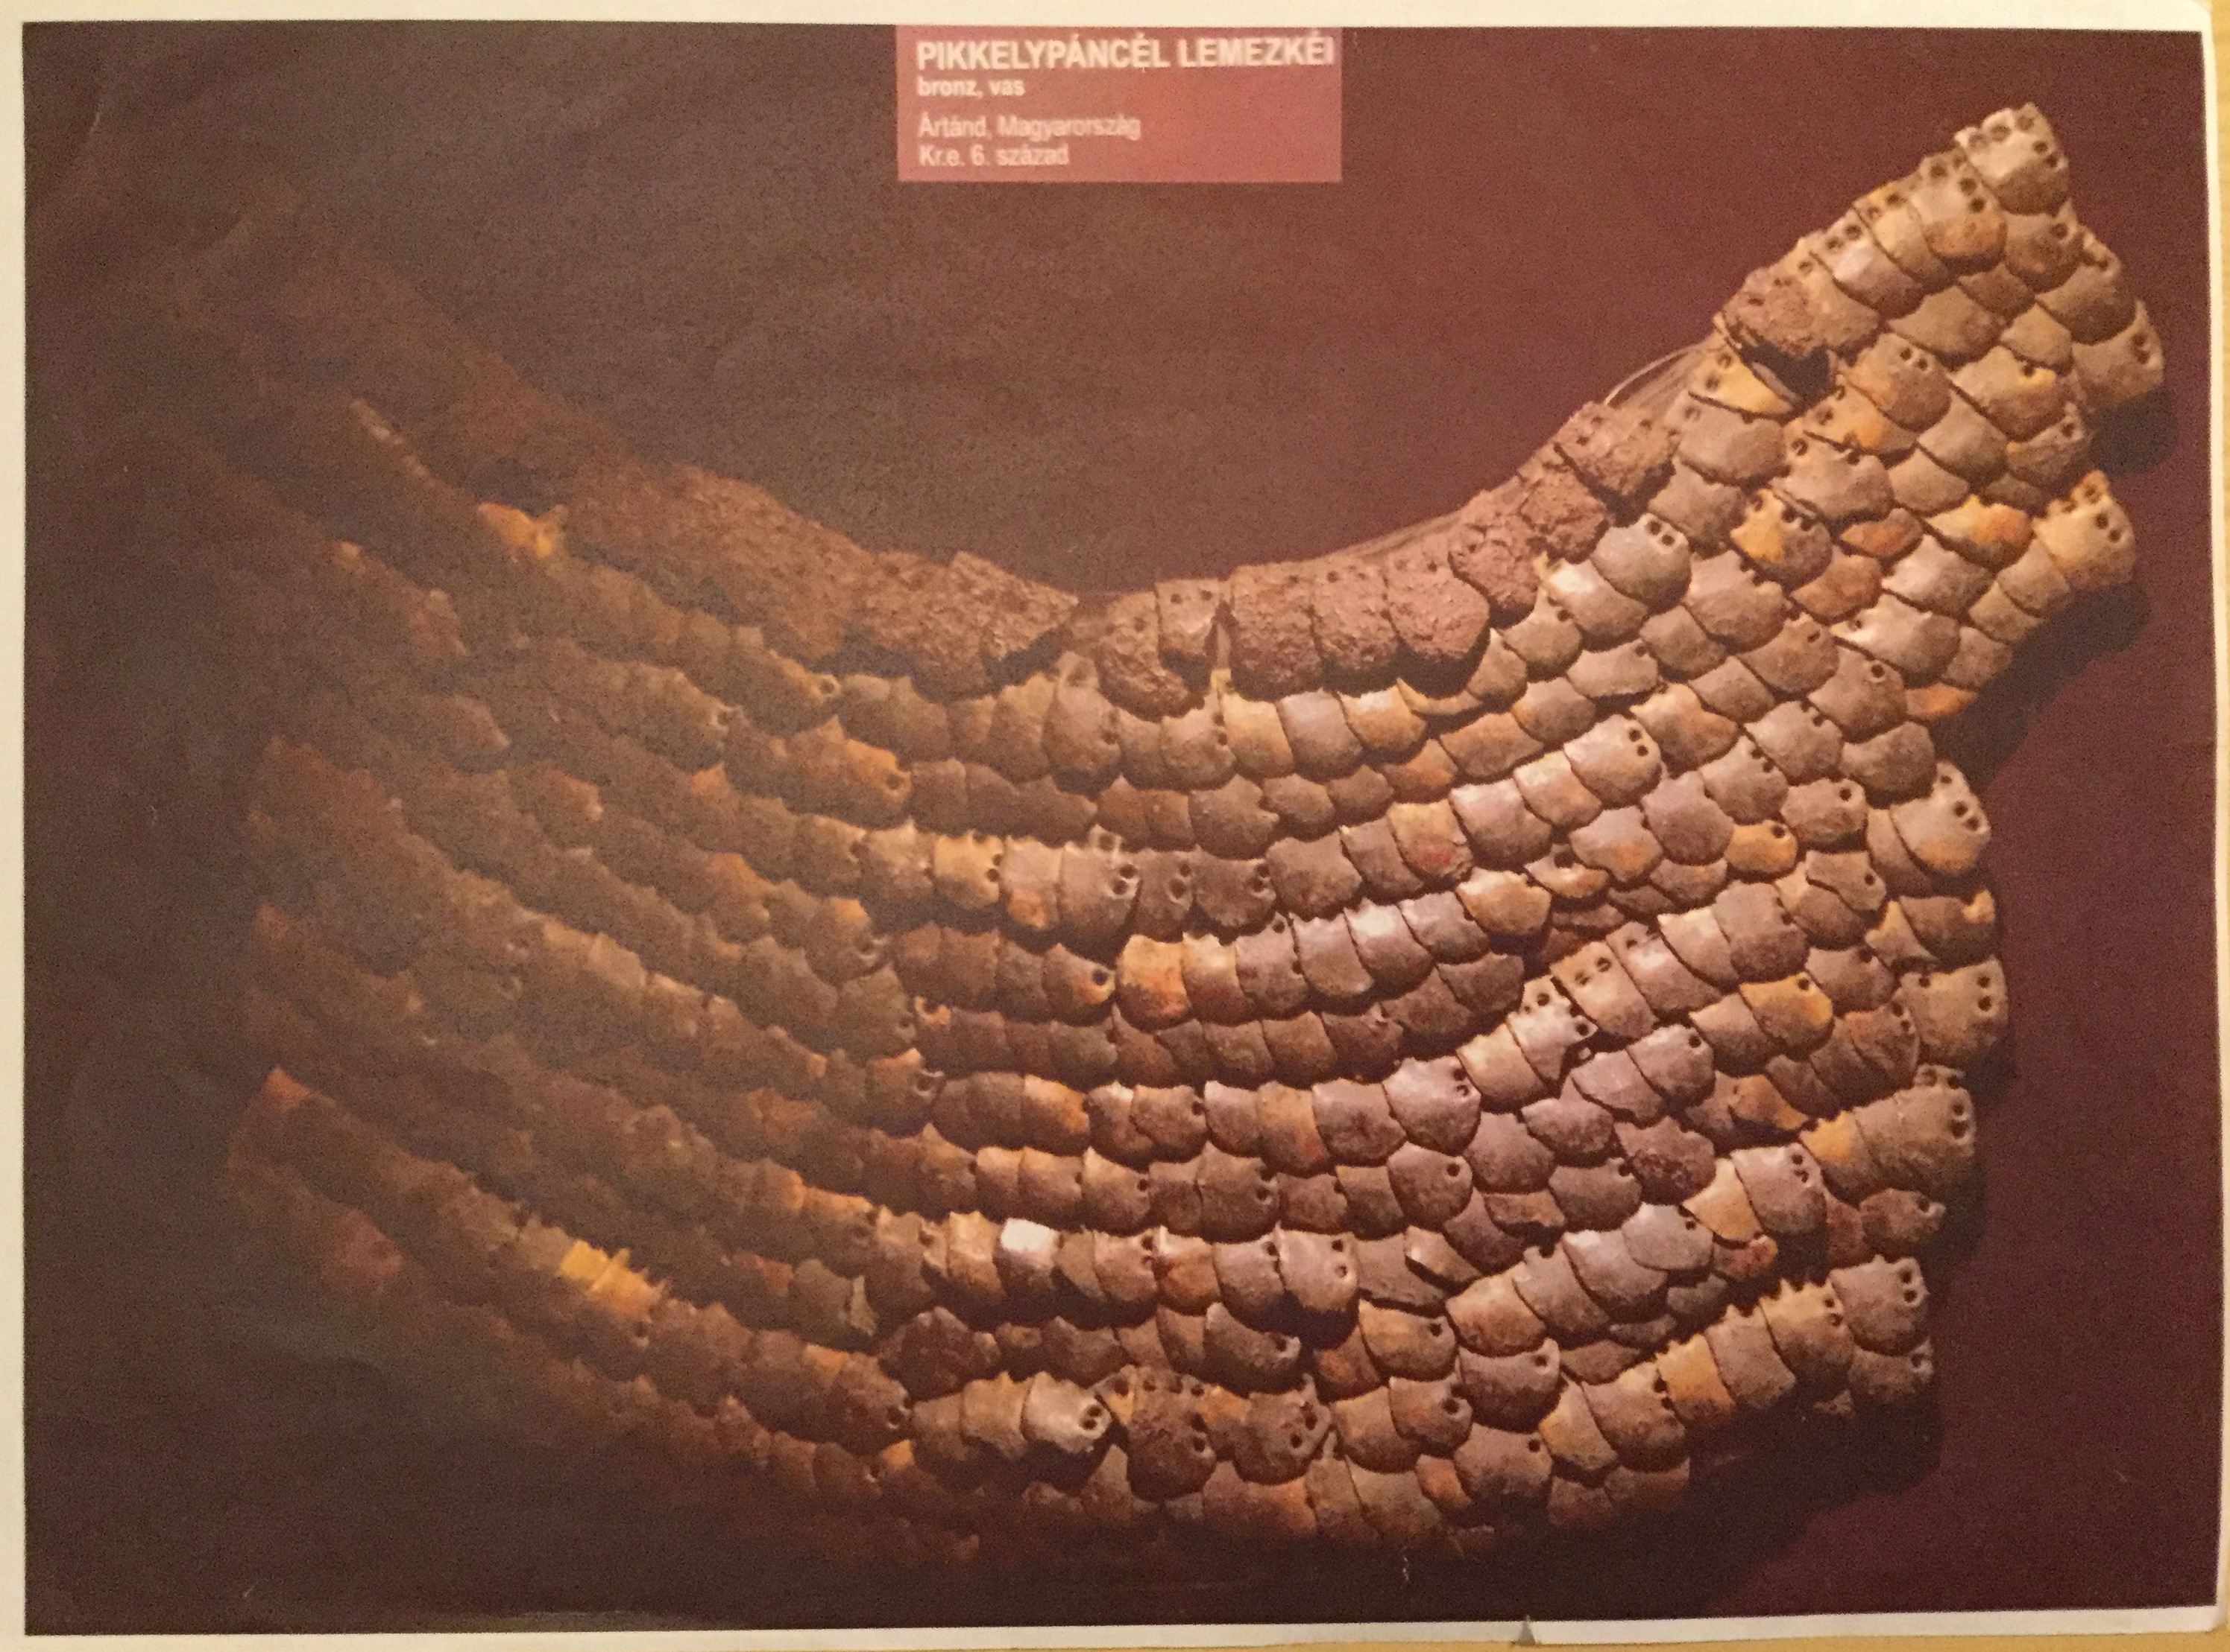
Scaled armor
Found in: Ártánd
Scythian weapons
Found in: Thügasken, Isik köl, Aldoboly

Slide 4
Scythian weapons
Found in: Arjan, Ártánd

Slide 5
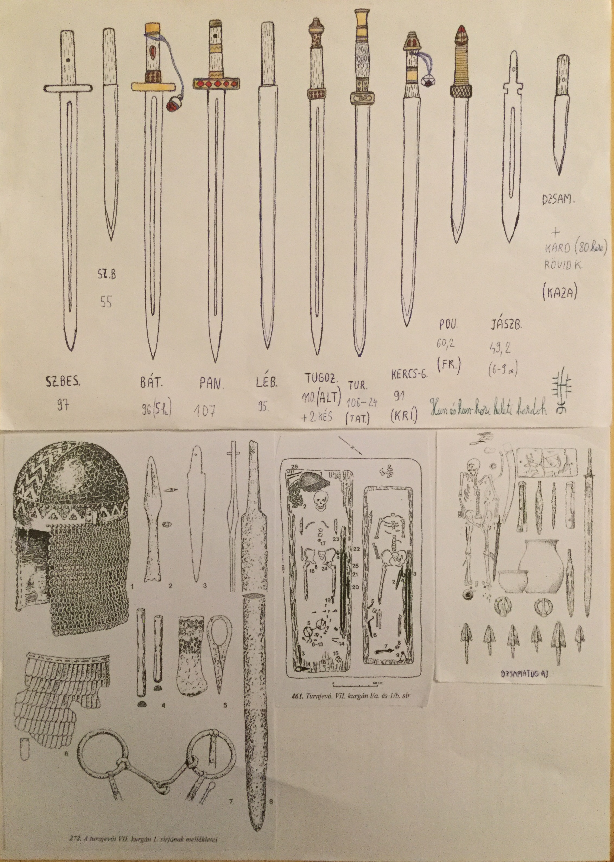
Different types of hun broadswords

Slide 6
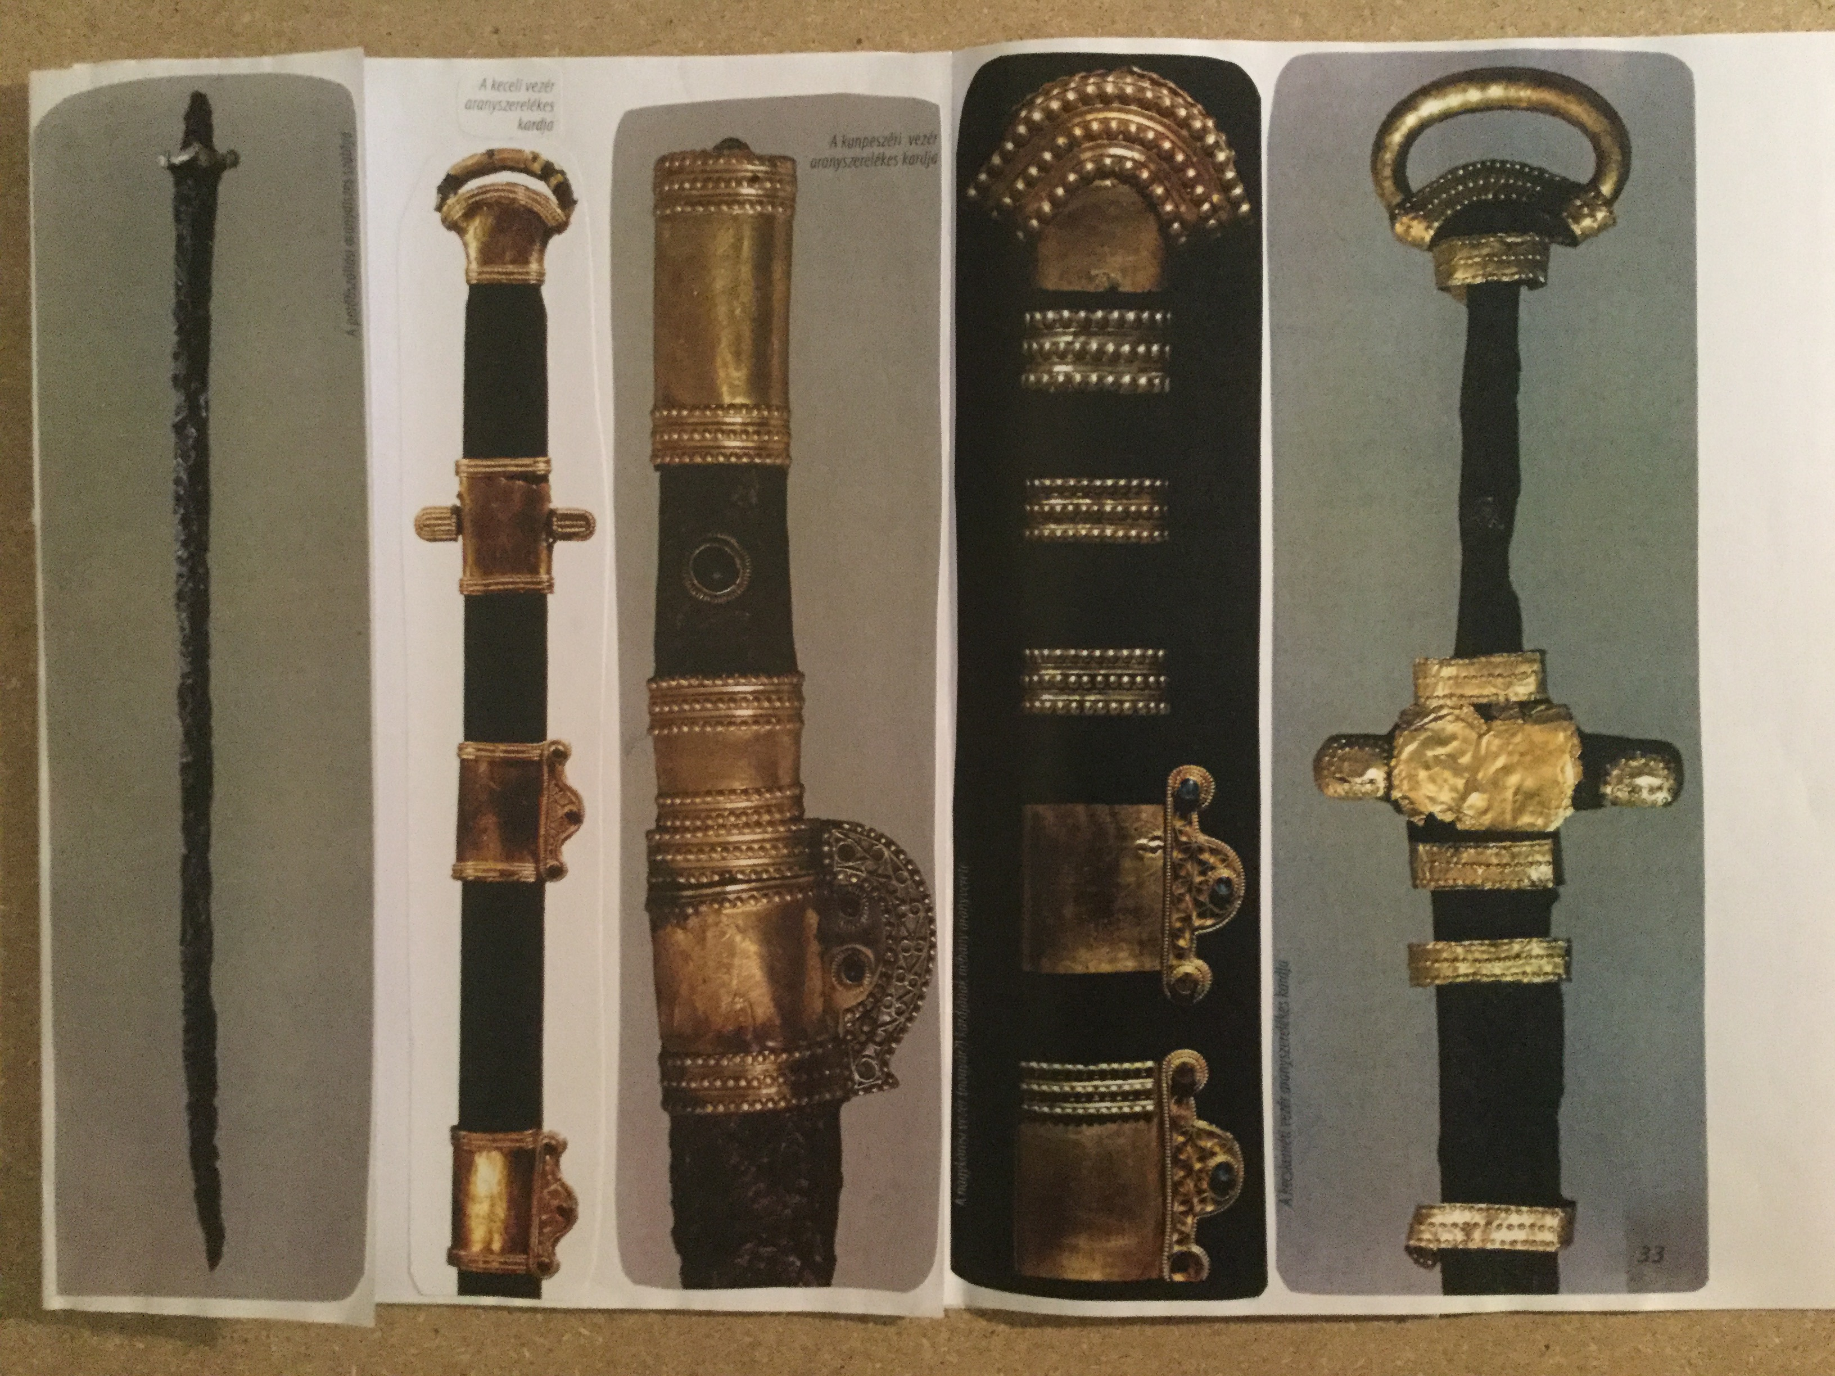
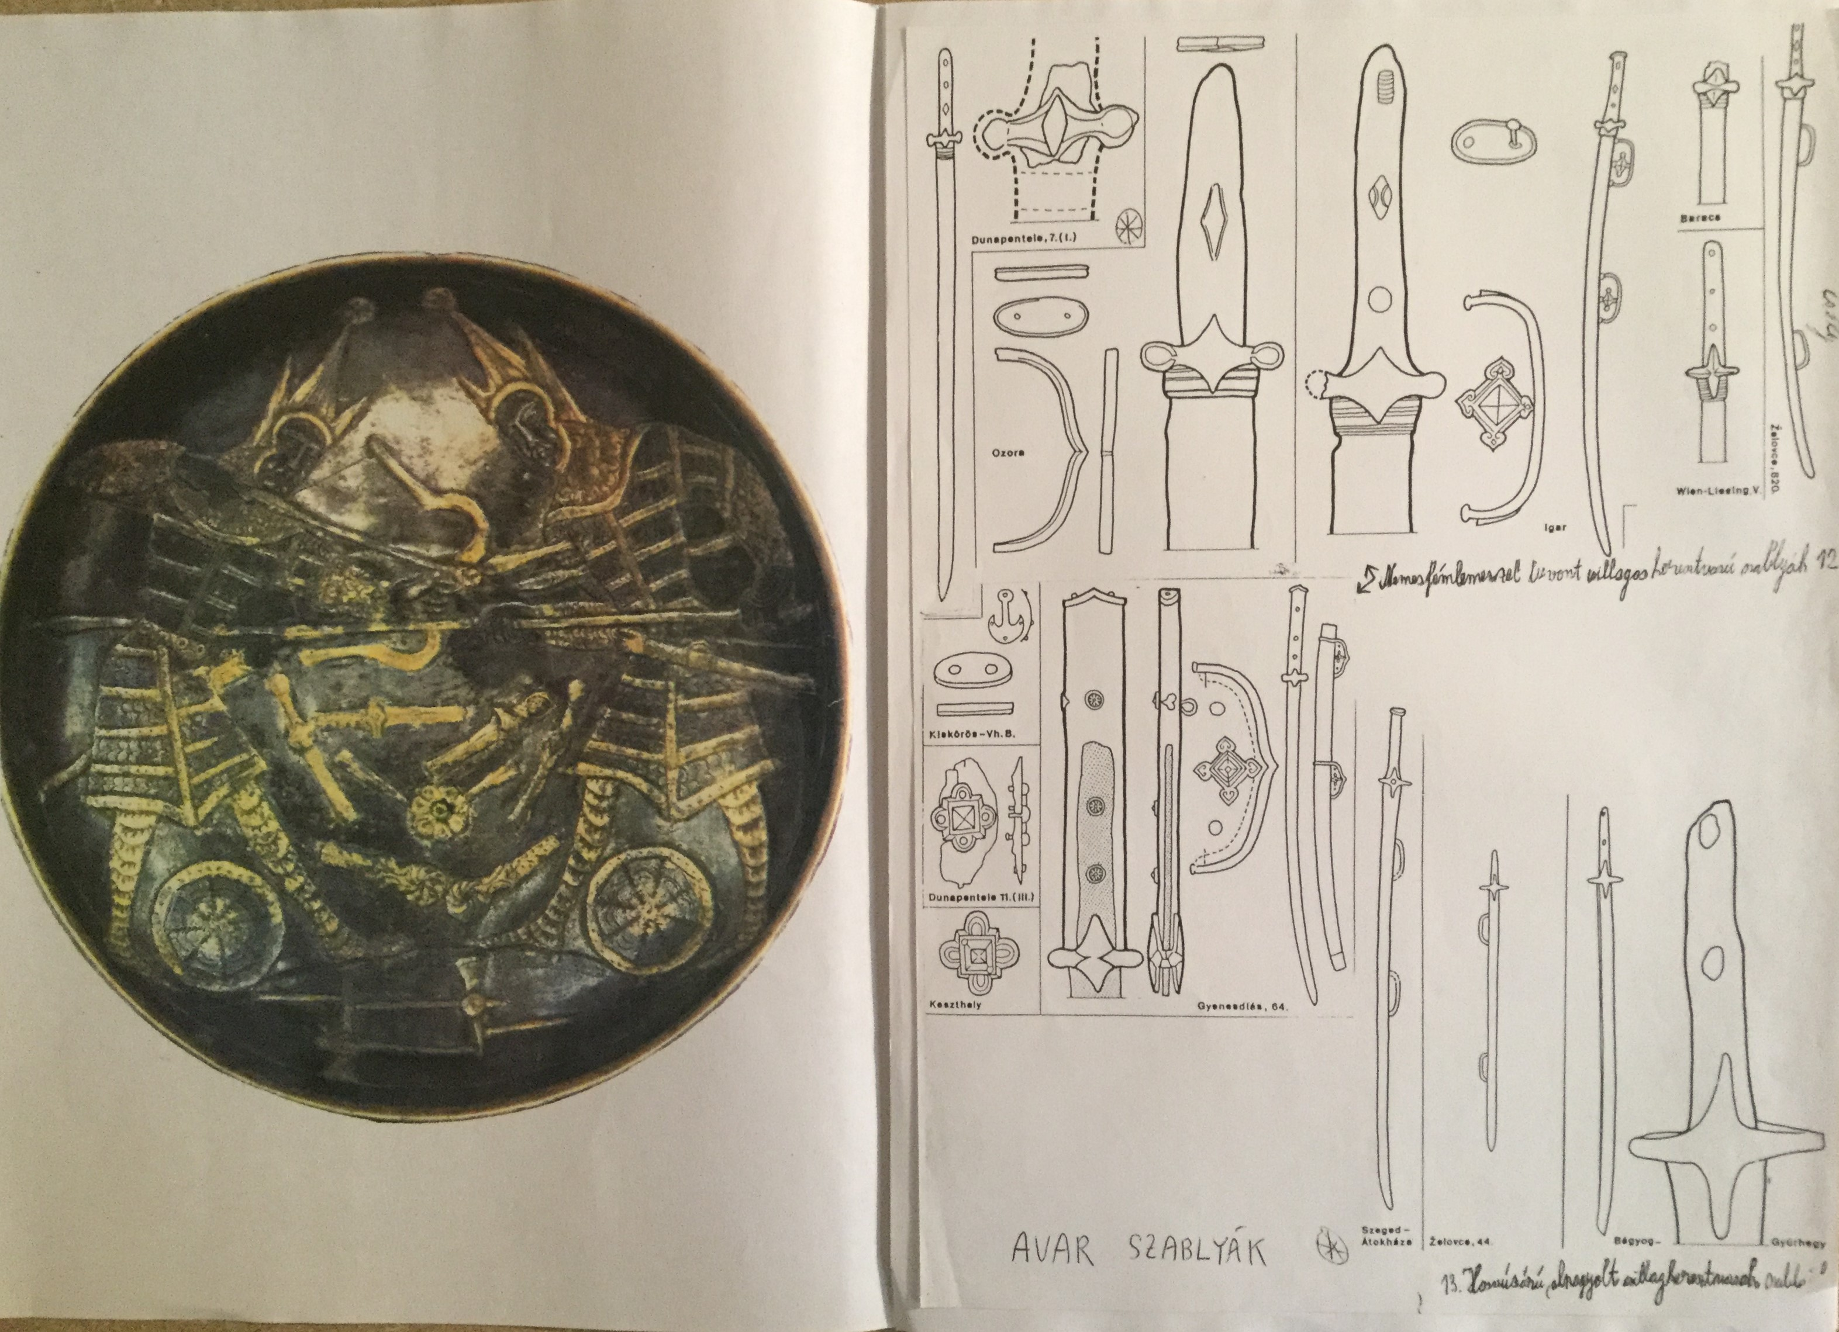
Avar – Joujan, Türk period

Slide 7
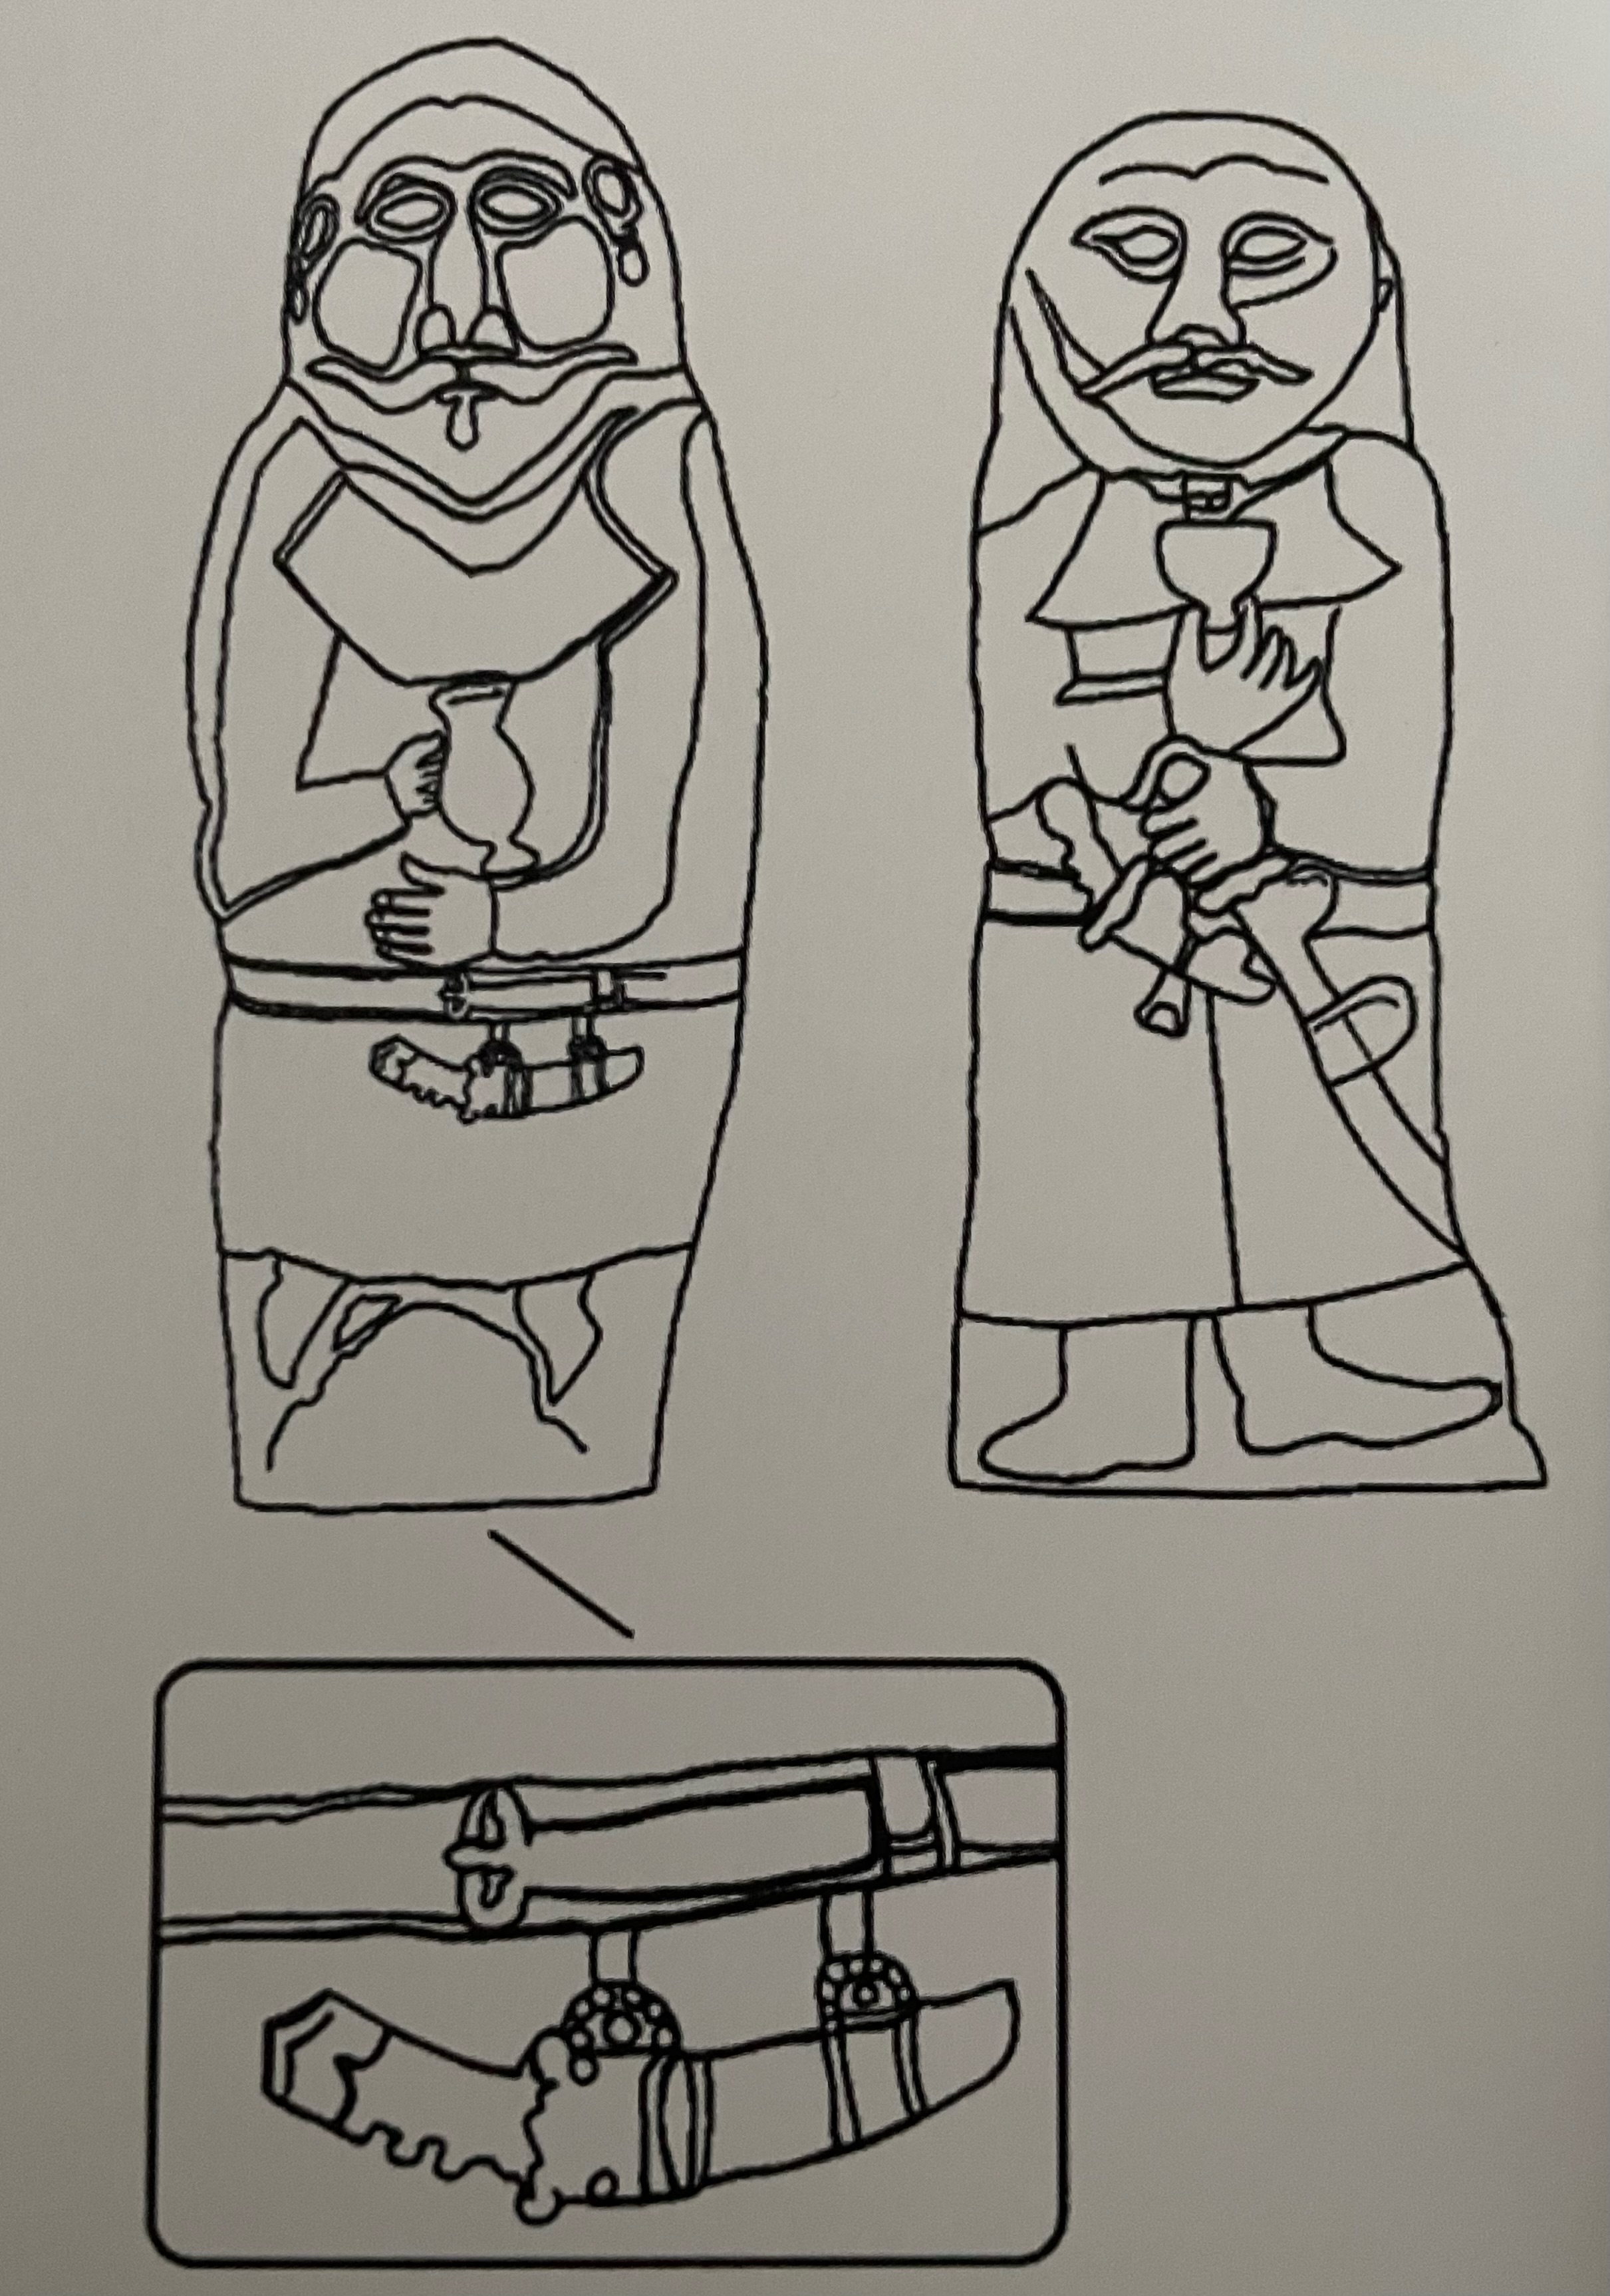
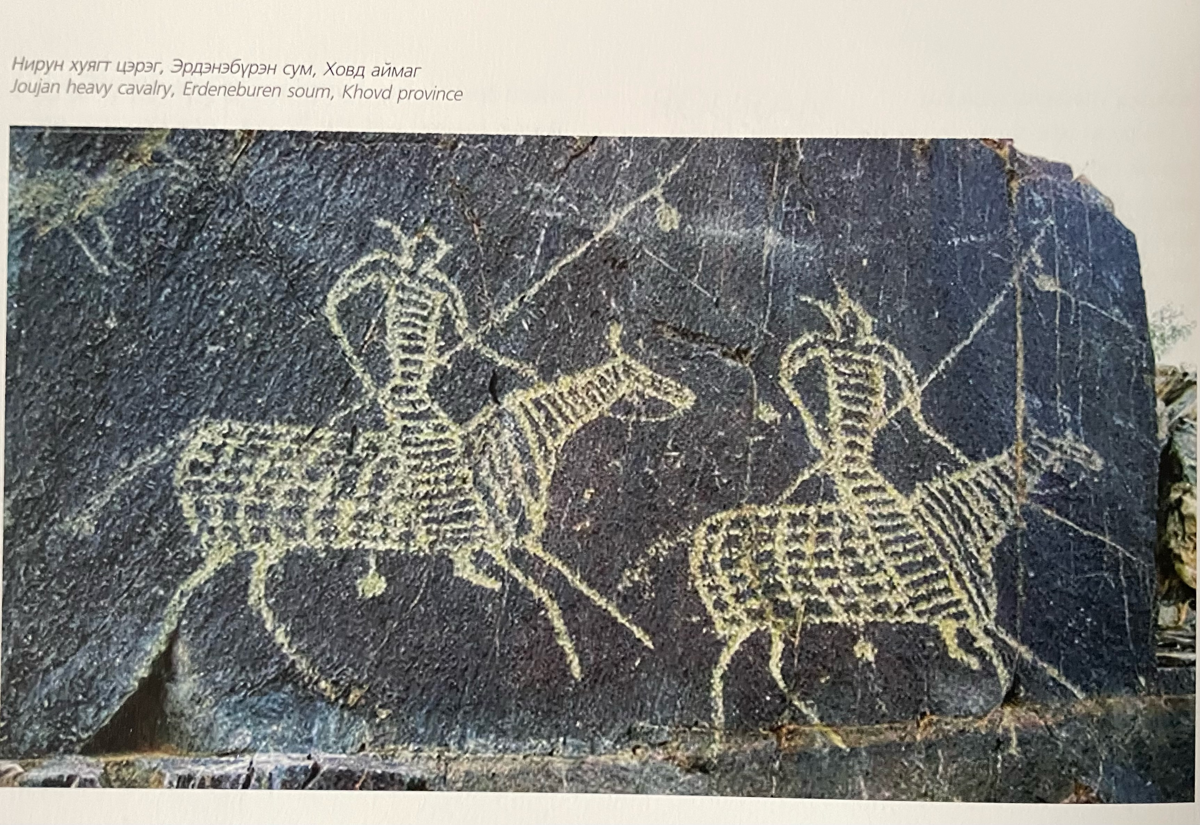
Avar – Joujan, Türk period

Slide 8
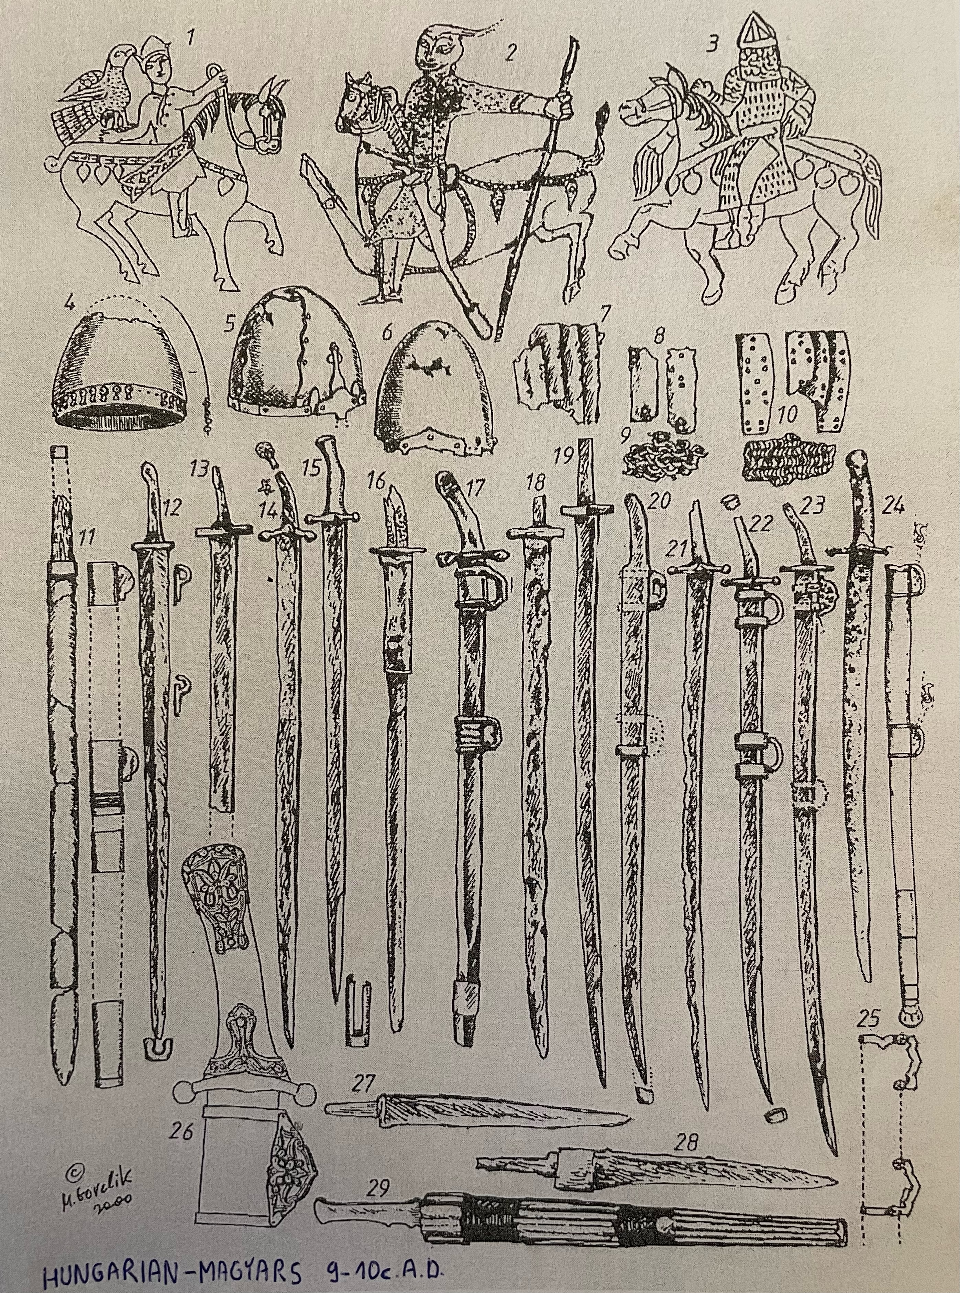
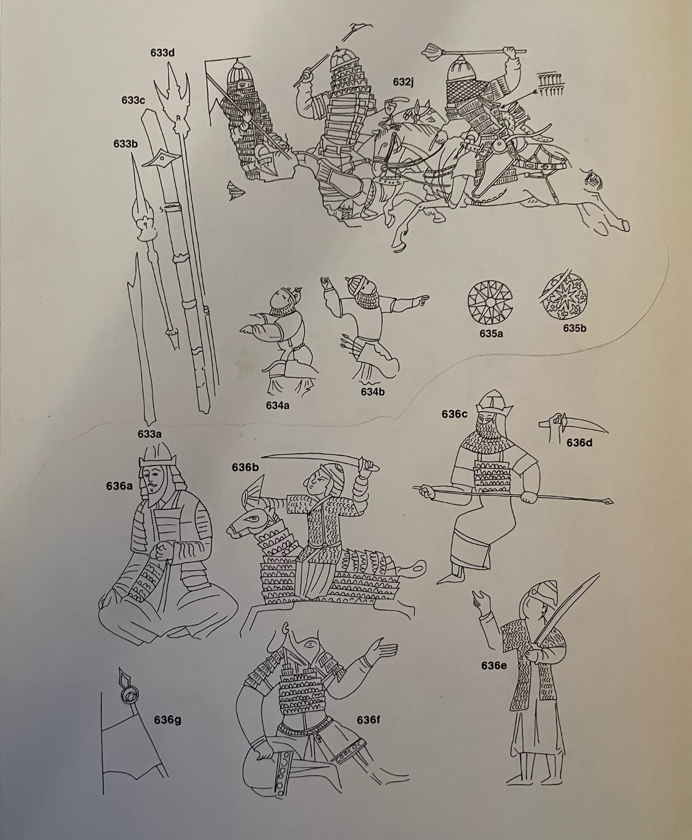
Hungarian – magyars, 9-10 c.
Mongols 13-14 c.

Slide 9
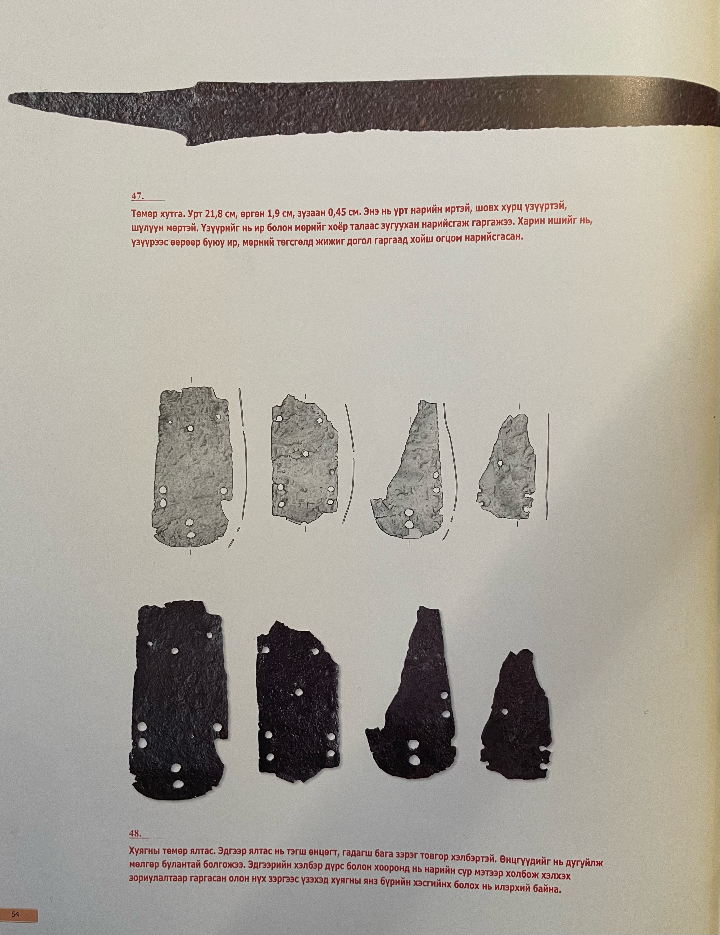
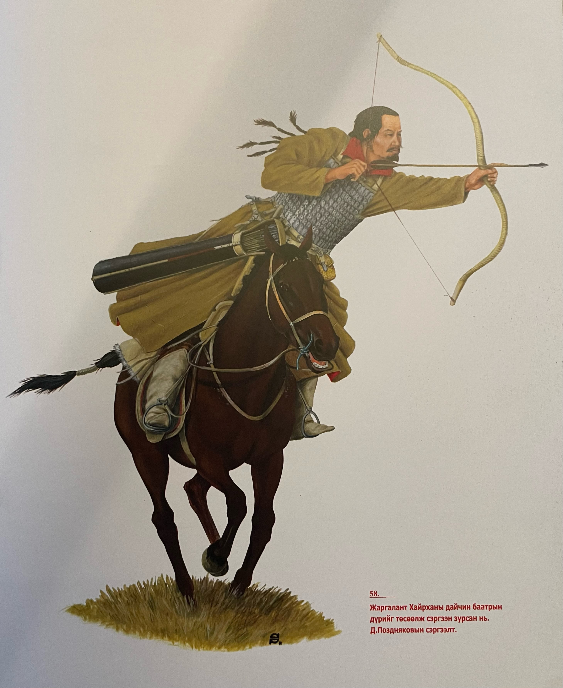
Archeological finds and reconstruction

Slide 10
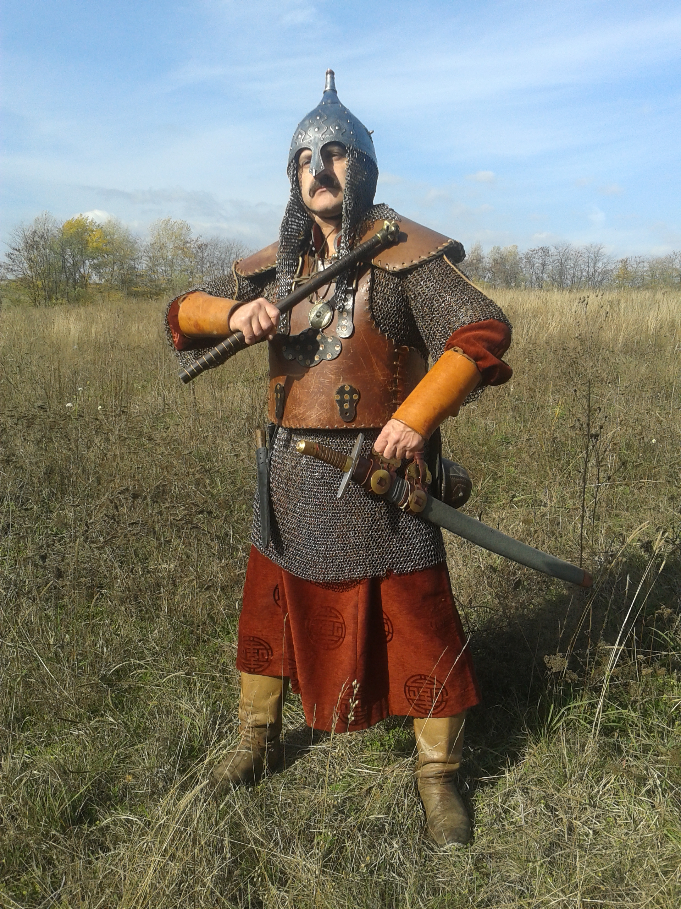
Thank you for your attention!

